Slide 1
Microprocessor & its Architecture

Slide 2
Objectives
Describe the function and purpose of each program-visible register in the 8086–Core2 microprocessors, including the 64-bit extensions.
Detail the flag register and the purpose of each flag bit.

Slide 3
Internal Microprocessor Architecture
In a multiple core microprocessor each core contains the same programming model
The Programming Model
The programming model of the 8086 through the Core2 is considered to be program visible because its registers are used during application programming and are specified by the instructions.
Other registers, are program invisible because they are not addressable directly during applications programming, but may be used indirectly during system programming.

Slide 4
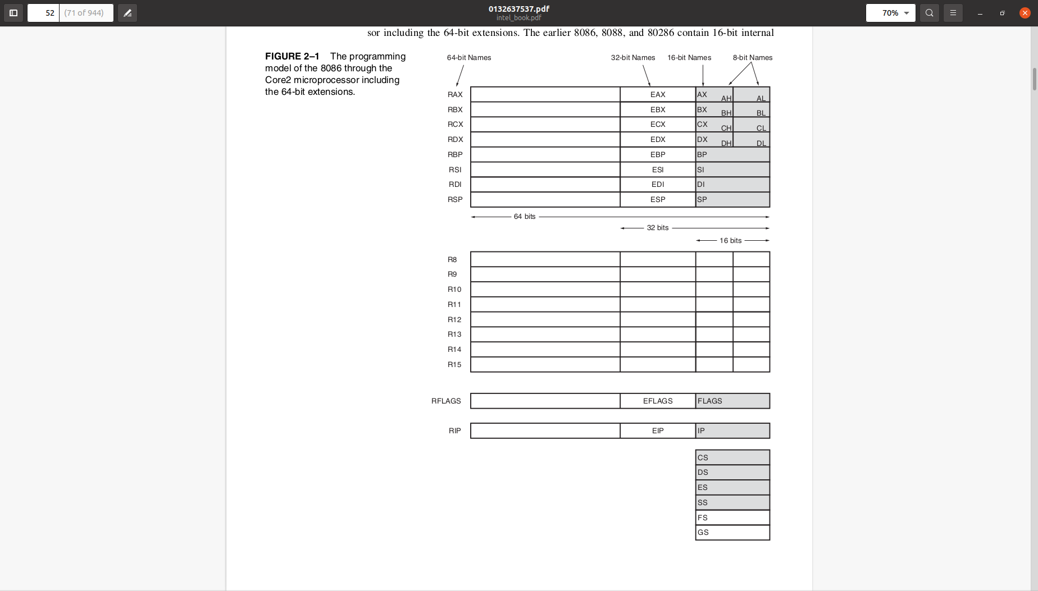

Slide 5
The earlier 8086, 8088, and 80286 contain 16-bit internal architectures, a subset of the registers.
The 80386 through the Core2 microprocessors contain full 32-bit internal architectures.
The architectures of the earlier 8086 through the 80286 are fully upward-compatible to the 80386 through the Core2.
The shaded areas in this illustration represent registers that are found in early versions of the 8086, 8088, or 80286 microprocessors and are provided on the 80386–Core2 microprocessors for compatibility to the early versions.

Slide 6
The programming model contains 8-, 16-, and 32-bit registers. The Pentium 4 and Core2 also contain 64-bit registers when operated in the 64-bit mode as illustrated in the programming model.
The 8-bit registers are AH, AL, BH, BL, CH, CL, DH, and DL and are referred to when an instruction is formed using these two-letter designations.
For example, an ADD AL,AH instruction adds the 8-bit contents of AH to AL.
Only AL changes due to this instruction.

Slide 7
The 16-bit registers are AX, BX, CX, DX, SP, BP, DI, SI, IP, FLAGS, CS, DS, ES, SS, FS, and GS.
Note that the first 4 16 registers contain a pair of 8-bit registers. An example is AX, which contains AH and AL.
The 16-bit registers are referenced with the two-letter designations such as AX.
For example, an ADD DX, CX instruction adds the 16-bit contents of CX to DX. (Only DX changes due to this instruction.)

Slide 8
The extended 32-bit registers are EAX, EBX, ECX, EDX, ESP, EBP, EDI, ESI, EIP, and EFLAGS.
These 32-bit extended registers, and 16-bit registers FS and GS, are available only in the 80386 and above.
The 16-bit registers are referenced by the designations FS or GS for the two new 16-bit registers, and by a three-letter designation for the 32-bit registers.
For example, an ADD ECX, EBX instruction adds the 32-bit contents of EBX to ECX. (Only ECX changes due to this instruction.)

Slide 9
Some registers are general-purpose or multipurpose registers, while some have special purposes.
The multipurpose registers include EAX, EBX, ECX, EDX, EBP, EDI, and ESI.
These registers hold various data sizes (bytes, words, or doublewords) and are used for almost any purpose, as dictated by a program.
The 64-bit registers are designated as RAX, RBX, and so forth.
In addition to the renaming of the registers for 64-bit widths, there are also additional 64-bit registers that are called R8 through R15.

Slide 10
Multipurpose registers
RAX - Accumulator
RAX is referenced as a 64-bit register (RAX), a 32-bit register (EAX)
a 16-bit register (AX), or as either of two 8-bit registers (AH and AL)
if an 8- or 16-bit register is addressed, only that portion of the 32-bit register changes without affecting the remaining bits.
The accumulator is used for instructions such as multiplication, division, and some of the adjustment instructions.
In the 80386 and above, the EAX register may also hold the offset address of a location in the memory system.

Slide 11
RBX
RBX is addressable as RBX, EBX, BX, BH, or BL.
The BX register (base index) sometimes holds the offset address of a location in the memory system in all versions of the microprocessor.
In the 80386 and above, EBX also can address memory data.
In the 64-bit Pentium 4 and Core2, RBX can also address memory data.

Slide 12
RCX (Count)
RCX, which is addressable as RCX, ECX, CX, CH, or CL, is a (count) general-purpose register that also holds the count for various instructions.
In the 80386 and above, the ECX register also can hold the offset address of memory data.
In the 64-bit Pentium 4, RCX can also address memory data.
Instructions that use a count are the repeated string instructions (REP/REPE/REPNE); and shift, rotate, and LOOP/LOOPD instructions.
The shift and rotate instructions use CL as the count, the repeated string instructions use CX, and the LOOP/LOOPD instructions use either CX or ECX.
If operated in the 64-bit mode, LOOP uses the 64-bit RCX register for the loop counter.

Slide 13
RDX(Data)
RDX, which is addressable as RDX, EDX, DX, DH, or DL, is a (data) general-purpose register that holds a part of the result from a multiplication or part of the dividend before a division.
In the 80386 and above, this register can also address memory data.

Slide 14
RBP (Base Pointer)
RBP, which is addressable as RBP, EBP, or BP, points to a memory (base pointer) location in all versions of the microprocessor for memory data transfers.

Slide 15
RDI, Destination Index, which is addressable as RDI, EDI, or DI, often addresses (destination index) string destination data for the string instructions.
RSI, Source Index, is used as RSI, ESI, or SI.
The source index register often (source index) addresses source string data for the string instructions.
Like RDI, RSI also functions as a general-purpose register.
As a 16-bit register, it is addressed as SI; as a 32-bit register, it is addressed as ESI; and as a 64-bit register, it is addressed as RSI.

Slide 16
R8 through R15
These registers are only found in the Pentium 4 and Core2 if 64-bit extensions are enabled.
As mentioned, data in these registers are addressed as 64-, 32-, 16-, or 8-bit sizes and are of general purpose.
Most applications will not use these registers until 64-bit processors are common.
Please note that the 8-bit portion is the rightmost 8-bit only; bits 8 to 15 are not directly addressable as a byte.

Slide 17
Special Purpose Register
RIP - Instruction Pointer
RIP addresses the next instruction in a section of memory defined as (instruction pointer) a code segment.
This register is IP (16 bits) when the microprocessor operates in the real mode and EIP (32 bits) when the 80386 and above operate in the protected mode.
Note that the 8086, 8088, and 80286 do not contain an EIP register and only the 80286 and above operate in the protected mode.
The instruction pointer, which points to the next instruction in a program, is used by the microprocessor to find the next sequential instruction in a program located within the code segment.
The instruction pointer can be modified with a jump or a call instruction.
In the 64-bit mode, RIP contains a 40-bit address at present to address a 1T flat address space.

Slide 18
RSP - Stack Pointer
RSP addresses an area of memory called the stack.
The stack memory (stack pointer) stores data through this pointer and is explained later in the text with the instructions that address stack data.
This register is referred to as SP if used as a 16-bit register and ESP if referred to as a 32-bit register.

Slide 19
RFLAGS
RFLAGS indicate the condition of the microprocessor and control its operation.
The flags are upward-compatible from the 8086/8088 through the Core2 microprocessors.
The 8086–80286 contain a FLAG register (16 bits) and the 80386 and above contain an EFLAG register (32-bit extended flag register).
The 64-bit RFLAGS contain the EFLAG register, which is unchanged in the 64-bit version.

Slide 20
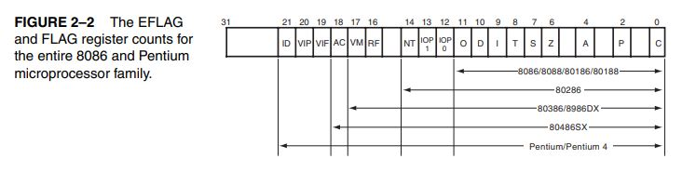

Slide 21
The rightmost five flag bits and the overflow flag change after many arithmetic and logic instructions execute.
The flags never change for any data transfer or program control operation.
Some of the flags are also used to control features found in the microprocessor.

Slide 22
C(carry) - Carry holds the carry after addition or the borrow after subtraction.
The carry flag also indicates error conditions, as dictated by some programs and procedures.
This is especially true of the DOS function calls.

Slide 23
Parity is a logic 0 for odd parity and a logic 1 for even parity.
Parity is the count of ones in a number expressed as even or odd.
For example, if a number contains three binary one bits, it has odd parity.
If a number contains no one bits, it has even parity.
The parity flag finds little application in modern programming and was implemented in early Intel microprocessors for checking data in data communications environments.
Today parity checking is often accomplished by the data communications equipment instead of the microprocessor.

Slide 24
A (auxiliary carry) The auxiliary carry holds the carry (half-carry) after addition or the borrow after subtraction between bit positions 3 and 4 of the result.
This highly specialized flag bit is tested by the DAA and DAS instructions to adjust the value of AL after a BCD addition or subtraction.
Otherwise, the A flag bit is not used by the microprocessor or any other instructions.

Slide 25
Z (zero) The zero flag shows that the result of an arithmetic or logic operation is zero.
If z = 1, the result is zero; if z = 0, the result is not zero.
This may be confusing, but that is how Intel decided to name this flag.

Slide 26
S (sign) The sign flag holds the arithmetic sign of the result after an arithmetic or logic instruction executes.
If S = 1, the sign bit (leftmost bit of a number) is set or negative; if S = 0, the sign bit is cleared or positive.

Slide 27
T (trap) The trap flag enables trapping through an on-chip debugging feature. (A program is debugged to find an error or bug.)
If the T flag is enabled (1), the microprocessor interrupts the flow of the program on conditions as indicated by the debug registers and control registers.
If the T flag is a logic 0, the trapping (debugging) feature is disabled.
The Visual C++ debugging tool uses the trap feature and debug registers to debug faulty software.

Slide 28
I (interrupt) The interrupt flag controls the operation of the INTR (interrupt request) input pin.
If I = 1, the INTR pin is enabled; if I = 0, the INTR pin is disabled.
The state of the I flag bit is controlled by the STI (set I flag) and CLI (clear I flag) instructions.

Slide 29
D (direction) The direction flag selects either the increment or decrement mode for the DI and/or SI registers during string instructions.
If D = 1, the registers are automatically decremented; if D = 0, the registers are automatically incremented.
The D flag is set with the STD (set direction) and cleared with the CLD (clear direction) instructions.

Slide 30
O (overflow) Overflows occur when signed numbers are added or subtracted.
An overflow indicates that the result has exceeded the capacity of the machine.
For example, if 7FH ( +127) is added—using an 8-bit addition—to 01H (+1 ), the result is 80H (–128).
This result represents an overflow condition indicated by the overflow flag for signed addition.
For unsigned operations, the overflow flag is ignored.

Slide 31
IOPL IO Privilege level - is used in protected mode operation to select the privilege (I/O privilege level) level for I/O devices.
If the current privilege level is higher or more trusted than the IOPL, I/O executes without hindrance.
If the IOPL is lower than the current privilege level, an interrupt occurs, causing execution to suspend.
Note that an IOPL of 00 is the highest or most trusted and an IOPL of 11 is the lowest or least trusted.

Slide 32
NT (nested task) The nested task flag indicates that the current task is nested within another task in protected mode operation.
This flag is set when the task is nested by software.
RF (resume) The resume flag is used with debugging to control the resumption of execution after the next instruction.

Slide 33
VM (virtual mode) The VM flag bit selects virtual mode operation in a protected mode system.
A virtual mode system allows multiple DOS memory partitions that are 1M byte in length to coexist in the memory system.
Essentially, this allows the system program to execute multiple DOS programs.
VM is used to simulate DOS in the modern Windows environment.

Slide 34
AC The alignment check flag bit activates if a word or doubleword is (alignment check) addressed on a non-word or non-doubleword boundary.
Only the 80486SX microprocessor contains the alignment check bit that is primarily used by its companion numeric coprocessor, the 80487SX, for synchronization.

Slide 35
VIF The VIF is a copy of the interrupt flag bit available to the Pentium– (virtual interrupt) Pentium 4 microprocessors.
VIP (virtual VIP provides information about a virtual mode interrupt for the interrupt pending) Pentium–Pentium 4 microprocessors.
This is used in multitasking environments to provide the operating system with virtual interrupt flags and interrupt pending information.
ID (identification) The ID flag indicates that the Pentium–Pentium 4 microprocessors support the CPUID instruction.
The CPUID instruction provides the system with information about the Pentium microprocessor, such as its version number and manufacturer.

Slide 36
Segment Registers. Additional registers, called segment registers, generate memory addresses when combined with other registers in the microprocessor.
There are either four or six segment registers in various versions of the microprocessor.
A segment register functions differently in the real mode when compared to the protected mode operation of the microprocessor.
Details on their function in real and protected mode are provided later in this chapter.
In the 64-bit flat model, segment registers have little use in a program except for the code segment register.

Slide 37
CS Code Segment
The code segment is a section of memory that holds the code (programs and procedures) used by the microprocessor.
The code segment register defines the starting address of the section of memory holding code.
In real mode operation, it defines the start of a 64Kbyte section of memory; in protected mode, it selects a descriptor that describes the starting address and length of a section of memory holding code.
The code segment is limited to 64K bytes in the 8088–80286, and 4G bytes in the 80386 and above when these microprocessors operate in the protected mode.
In the 64-bit mode, the code segment register is still used in the flat model, but its use differs from other programming modes.

Slide 38
DS Data Segment
The data segment is a section of memory that contains most data used by a program.
Data are accessed in the data segment by an offset address or the contents of other registers that hold the offset address.
As with the code segment and other segments, the length is limited to 64K bytes in the 8086–80286, and 4G bytes in the 80386 and above.
ES (extra) The extra segment is an additional data segment that is used by some of the string instructions to hold destination data.

Slide 39
Stack Segment
The stack segment defines the area of memory used for the stack.
The stack entry point is determined by the stack segment and stack pointer registers.
The BP register also addresses data within the stack segment.

Slide 40
FS and GS
The FS and GS segments are supplemental segment registers available in the 80386–Core2 microprocessors to allow two additional memory segments for access by programs.
Windows uses these segments for internal operations, but no definition of their usage is available.

